Slide 1
T-SQL

Slide 2
T-SQL (Transact SQL)
Transact-SQL is Microsoft’s and Sybase’s proprietary extension to the conventional SQL (structured query language). Transact-SQL is sometimes abbreviated as T-SQL. This enhancement brought procedural programming language functionalities, such as local variables, control-of-flow constructs (If ... Else; begin … end; continue command; break command; looping etc), additional functions for various needs as well as a provision of creating our own functions or procedures, etc
Hence we can regard T-SQL as a language.

Slide 3
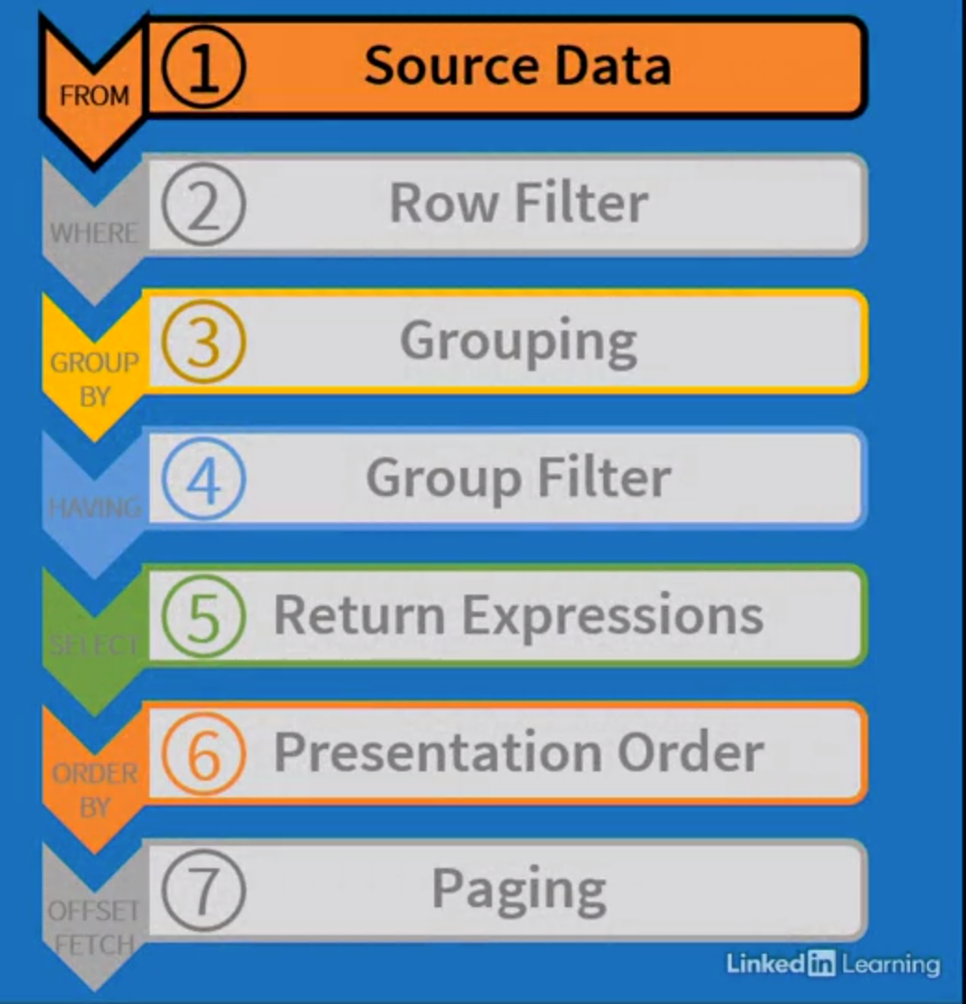
Logical Query Processing
1. FROM
2. ON
3. JOIN
4. WHERE
5. GROUP BY
6. WITH CUBE/ROLLUP
7. HAVING
8. SELECT
9. DISTINCT
10. ORDER BY
11. TOP
12. OFFSET/FETCH

Slide 4
SQL Anatomy
SELECT<select list>Defines which columns to return
FROM<table source>Defines table(s) to query
WHERE<search condition>Filters returned data using a predicate
GROUP BY<group by list>Arranges rows by groups
HAVING Filters groups by a predicate
ORDER BY<order by list>Sorts the results

Slide 5
SQL Anatomy
What columns will appear
  Select branchID, Count(staff_id)
  From workers
  Where branchType = ‘Main’
  Group by branchID
  Having Count (staff_id) > 1
  Order by branchID
Which table
Condition
Groups by some column
Value
Restricts what will
Be grouped
Specifies the order of the result

Slide 6
AGGREGATE FUNCTION
  Count – returns number of values in a column
  Sum – returns the sum total of values of a column
  Avg – returns the mean average of values in column
  Min – returns the lowest value in a column
  Max – returns the highest value in a column

Slide 7
GROUP BY
The GROUP BY clause divides the rows returned from the SELECT statement into groups. For each group, you can apply an aggregate function
Syntax:
SELECT column_1, aggregate_function(column_2)
FROM tbl_name
GROUP BY column_1;
If GROUP BY is used without aggregated function it will act like DISTINCT clause

Slide 8
HAVING
We often use the HAVING clause in conjunction with the GROUP BY clause to filter group rows that do not satisfy a specified condition.
Syntax:
SELECT
  column_1,
  aggregate_function (column_2)
FROM
tbl_name
GROUP BY
column_1
HAVING
condition;

Slide 9
JOINS
JOINS are used to retrieve data from multiple tables. JOIN is performed whenever two or more tables are joined in a SQL statement.
There are 4 different types of joins:
INNER JOIN (or sometimes called simple join)
OUTER JOIN
  → LEFT OUTER JOIN (or sometimes called LEFT JOIN
  → RIGHT OUTER JOIN (or sometimes called RIGHT JOIN)
  → FULL OUTER JOIN (or sometimes called FULL JOIN)
SELF JOIN
CROSS JOIN

Slide 10
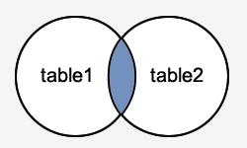
JOINS
INNER JOIN
It is the most common type of join. INNER JOINS return all rows from multiple tables where the join condition is met.
SELECT columns
FROM table1
INNER JOIN table2
ON table1.column = table2.column;

Slide 11
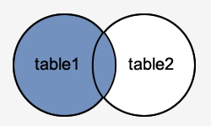
JOINS
LEFT OUTER JOIN
Another type of join is called an LEFT OUTER JOIN. This type of join returns all rows from the LEFT-hand table specified in the ON condition and only those rows from the other table where the joined fields are equal (join condition is met).
SELECT columns
FROM table1
LEFT [OUTER] JOIN table2
ON table1.column = table2.column;

Slide 12
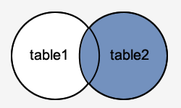
JOINS
RIGHT OUTER JOIN
Another type of join is called an RIGHT OUTER JOIN. This type of join returns all rows from the RIGHT-hand table specified in the ON condition and only those rows from the other table where the joined fields are equal (join condition is met).
SELECT columns
FROM table1
RIGHT [OUTER] JOIN table2
ON table1.column = table2.column;

Slide 13
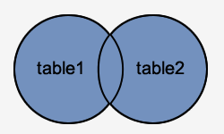
JOINS
FULL OUTER JOIN
Another type of join is called an FULL OUTER JOIN. This type of join returns all rows from the LEFT-hand table and RIGHT-hand table with nulls in place where the join condition is not met.
SELECT columns
FROM table1
FULL [OUTER] JOIN table2
ON table1.column = table2.column;

Slide 14
JOINS
SELF JOIN
A self-join is a query in which a table is joined to itself. Self-joins are useful for comparing values in a column of rows within the same table.
SELECT column_list
FROM A a1
INNER JOIN A b1 ON join_predicate;

Slide 15
JOINS
CROSS JOIN
A CROSS JOIN clause allows you to produce the Cartesian Product of rows in two or more tables.
SELECT * FROM T1 CROSS JOIN T2;
SELECT * FROM T1, T2;
SELECT * FROM T1 INNER JOIN T2 ON TRUE;

Slide 16
UNION
UNION concatenates the results of two queries into a single result set. The result can be controlled to includes duplicate rows:
  UNION ALL - Includes duplicates.
  UNION - Excludes duplicates.
A UNION operation is different from a JOIN:
A UNION concatenates result sets from two queries. But a UNION does not create individual rows from columns gathered from two tables.
A JOIN compares columns from two tables, to create result rows composed of columns from two tables.
Example:
SELECT first_name,last_name FROM sales.staffs
UNION
SELECT first_name,last_name FROM sales.customers;

Slide 17
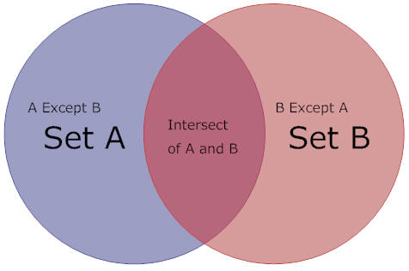
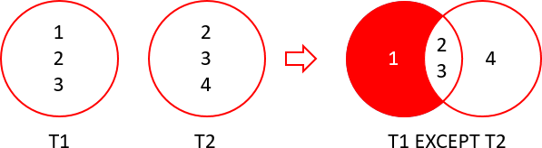
INTERSECTION / EXCEPT
INTERSECT returns distinct rows that are output by both the left and right input queries operator.
EXCEPT returns distinct rows from the left input query that aren't output by the right input query.

Slide 18
Pattern Matching
The SQL Server LIKE is a logical operator that determines if a character string matches a specified pattern. A pattern may include regular characters and wildcard characters. The LIKE operator is used in the WHERE clause of the SELECT, UPDATE, and DELETE statements to filter rows based on pattern matching.
Pattern
The pattern is a sequence of characters to search for in the column or expression. It can include the following valid wildcard characters:
The percent wildcard (%): any string of zero or more characters.
The underscore (_) wildcard: any single character.
The [list of characters] wildcard: any single character within the specified set.
The [character-character]: any single character within the specified range.
The [^]: any single character not within a list or a range.

Slide 19
Pattern Matching
Like
column | expression LIKE pattern [ESCAPE escape_character]
Example:
SELECT first_name,last_name FROM customer
WHERE first_name LIKE 'Jen%’;
SELECT customer_id, first_name, last_name FROM sales.customers
WHERE last_name LIKE '_u%’
ORDER BY first_name;
SELECT customer_id, first_name, last_name FROM sales.customers
WHERE last_name LIKE '[YZ]%’
ORDER BY last_name;
SELECT customer_id,first_name,last_name FROM sales.customers
WHERE last_name LIKE '[A-C]%' ORDER BY first_name;
SELECT [Description] FROM Production.ProductDescription]
where [Description] like '[^A-T]%'

Slide 20
COALESCE / NULLIF
COALESCE:
It evaluates the arguments in order and returns the current value of the first expression that initially doesn't evaluate to NULL.
Example:
SELECT COALESCE(NULL, NULL, 'third_value', 'fourth_value’);
Above query returns the third value because the third value is the first value that isn't null.
NULLIF:
Returns a null value if the two specified expressions are equal.
Example:
SELECT NULLIF(4,4) AS Same, NULLIF(5,7) AS Different;
Above query returns NULL for the first column (4 and 4) because the two input values are the same. The second column returns the first value (5) because the two input values are different.

Slide 21
CASE Statement
There are mainly two ways to write CASE statement.
Using an input expression or a Boolean expression that will be compared with the value used in the When clause. This is termed as a simple CASE.
In the next type CASE, there is no input expression. Each when clause expression must evaluate to a Boolean value. This type of CASE is a Searched CASE.

Slide 22
CASE Statement Example
Simple Case Statement:
SELECT Category =
CASE type
WHEN 'popular_comp' THEN 'Popular Computing'
WHEN 'mod_cook' THEN 'Modern Cooking'
WHEN 'business' THEN 'Business'
WHEN 'psychology' THEN 'Psychology'
WHEN 'trad_cook' THEN 'Traditional Cooking'
ELSE 'Not yet categorized'
END,
CAST(title AS varchar(25)) AS 'Shortened Title',
price AS Price
FROM titles
WHERE price IS NOT NULL
ORDER BY type, price

Slide 23
CASE Statement Example
A Searched CASE
SELECT 'Price Category' =
CASE
WHEN price IS NULL THEN 'Not yet priced'
WHEN price < 10 THEN 'Very Reasonable Title'
WHEN price >= 10 and price < 20 THEN 'Coffee Table Title'
ELSE 'Expensive book!'
END,
CAST(title AS varchar(20)) AS 'Shortened Title'
FROM titles
SELECT SUBSTRING((RTRIM(a.au_fname) + ' '+
RTRIM(a.au_lname) + ' '), 1, 25) AS Name, a.au_id, ta.title_id,
Type = CASE
    WHEN SUBSTRING(ta.title_id, 1, 2) = 'BU' THEN 'Business'
    WHEN SUBSTRING(ta.title_id, 1, 2) = 'MC' THEN 'Modern Cooking'
    WHEN SUBSTRING(ta.title_id, 1, 2) = 'PC' THEN 'Popular Computing'
    WHEN SUBSTRING(ta.title_id, 1, 2) = 'PS' THEN 'Psychology'
    WHEN SUBSTRING(ta.title_id, 1, 2) = 'TC' THEN 'Traditional Cooking’
END
FROM titleauthor ta JOIN authors a ON ta.au_id = a.au_id

Slide 24
Flow of Control language
This language controls the flow of execution of SQL statements in batches, stored procedures, triggers and transactions etc. It is typically used when statements have to be conditionally or repeatedly executed.
SQL server provides following three flow of control statements
  IF, for conditional execution
  While, for looping
  Return, for conditional exit from a batch or procedure

Slide 25
Flow of Control
BEGIN …END
  Group multiple statements together in a statement block.
  This don’t alter execution order of the statements
  This does not define an atomic transaction
  Format:
  BEGIN
  {SQL Statement | statement block}
  END
  Note
  T-SQL’s BEGIN…END keywords create a statement block but do not define a scope
  Example:
  BEGIN
  DECLARE @j INT;
  SELECT @j = 10;
  END
      PRINT @j

Slide 26
IF … Statement
This is used to execute SQL statements conditionally.
Example 1:
Declare @price money
Select @Price = Price from title
Where title_Id = 'BU1111'
If @Price < 10
Print 'Under 10'
Else
Print 'Equal to or Over 10'

Slide 27
While construct
The while command repeats a statement(s) until the while test is false.
Example 1:
WHILE (SELECT AVG(price) FROM titles) < $30
BEGIN
UPDATE titles
SET price = price * 2
SELECT MAX(price) FROM titles
IF (SELECT MAX(price) FROM titles) > $50
BREAK
ELSE
CONTINUE
END
PRINT 'Too much for the market to bear’
Continue and Break keywords inside While construct
Continue immediately jumps to the top of the while loop and re-evaluates the condition. If the condition tests true, processing continues with the first statement in the while code block. If the condition tests false, the loop is exited.
Break immediately exits while loop.

Slide 28
Return
Exits unconditionally from a query or procedure. RETURN is immediate and complete and can be used at any point to exit from a procedure, batch, or statement block. Statements that follow RETURN are not executed.
Format:
RETURN {integer expression}
If {integer expression} is not defined, by default it returns 0;
Example:
CREATE PROCEDURE findjobs @nm sysname = NULL
AS
IF @nm IS NULL
BEGIN
PRINT 'You must give a user name'
RETURN
END
ELSE
BEGIN
SELECT o.name, o.id, o.uid FROM sysobjects o INNER JOIN master..syslogins l ON o.uid = l.sid
WHERE l.name = @nm
END;

Slide 29
Batches
A batch is one or more SQL statements that are sent to the server to be compiled and executed as single unit.
Example:
select * from Employees
select * from Products
go
select * from Orders
select * from OrderDetails
Go
When a server receives a batch of commands, it will go following steps
Parse: In parsing process, the SQL commands are checked for validity of syntax. If the batch is syntactically correct, the server will check for the existence of the objects such as tables, stored procedure etc.
Optimize: In this process, the servers makes an effective plan to get and process data in the fastest way. Such plan is known as query plan.
Compile: The query plan is compiled
Execute: The compiled query plan is executed at the server side.

Slide 30
Batches
  Statements that cannot be combined with batch
    Following CREATE statements must be a single Statement in a batch
      Create database
      Create table
      Create default
      Create trigger
      Create view
Further:
  You cannot define and use the check constraint in the same batch
  You cannot alter a table and reference the new column in the same batch
  You cannot drop objects and recreate them in the same batch

Slide 31
Local Variable
Variables allow you to store temporary values inside a batch, stored procedures, or trigger. They are often used in loop counters in while loop. The local variable can be created using declare statement as below:
Syntax:
Declare @VariableName DataType
Declare @MyVar int
Declare
@msg varchar(20)
After declaration, variables have NULL values.
Assigning Values to a variable
Declare @MyVar int
Select @MyVar = 1
Select @Myvar

Slide 32
Local Variable
Difference between SET and SELECT
SET requires us to use a scalar subquery to pull data from table. Scalar subquery fails at run time if it returns more than one value
The assignment SELECT has Predictable behaviors when exactly one row qualifies.
Example:
-- Case 1 : Using SELECT
DECLARE @personName AS NVARCHAR(61)
SELECT @personName = firstname + N’ ’ + lastname
FROM Person.Contact
WHERE LastName Like ‘Smith%’
SELECT @personName AS PersonName;
-- Case 21 : Using SET
DECLARE @personName AS NVARCHAR(61)
SET @personName = (SELECT firstname + N’ ’ + lastname
FROM Person.Contact
WHERE LastName Like ‘Smith%’)
SELECT @personName AS PersonName;

Slide 33
Local Variable and Batches
Scope of local variable is inside a single batch only
Example:
DECLARE @idx AS INT
SET @idx = 10
Print @idx
GO
Print @idx

Slide 34
Global Variables
Used on SQL Server to communicate information to the client.
Read Only
Prefixed with @@
There are two types of Global Variables
Server Specific
  @@servername : The name of the server to which you are currently connected
  @@version : Version information of the server
  @@connections : Number of Logins (Successful and Failed)
Connection Specific
  @@error: 0 if the last command succeeded, else a number other than 0 will be returned
  @@identity: Returns IDENTITY column value inserted by the server when a table had a value inserted
  @@rowcount: returns the number of the rows affected by the last statement
  @@spid: The Server process ID number for the current process
Example:
Print ‘Server Information:
Server name:’ + @@servername+’
MS SQL Version :’+@@version
SELECT * FROM Person.Address
Print ‘SELECT statement returned ‘ + CAST (@@rowcount as VARCHAR)+’ rows

Slide 35
Temporary Table
In SQL Server there we can create two types of Temporary table:
Local Temporary Table:
Temporary tables are tables that exist temporarily on the SQL Server.
Temporary tables are particularly useful when you have a large number of records in a table and you repeatedly need to interact with a small subset of those records. In such cases instead of filtering the data again and again to fetch the subset, you can filter the data once and store it in a temporary table.
The temporary tables are useful for storing the immediate result sets that are accessed multiple times.
SQL Server local temp tables are created using the pound symbol(#) followed by the table name.
Local temporary table is only accessible to the connection that created that temporary table. It is not accessible to other connections.
Global Temporary Table:
We can also create temporary tables that are accessible to all the open connections. Such temporary tables are called global temporary tables. The name of the global temporary table starts with a double hash symbol (##).

Slide 36
Temporary Table
Method 1:
The simplest way of creating a temporary table is by using an INTO statement within a SELECT query.
SELECT name, age, gender
INTO #MaleStudents
FROM student
WHERE gender = 'Male'
Method 2:
The second method is similar to creating normal tables.
CREATE TABLE #MaleStudents(
name VARCHAR(50),
age int,
gender VARCHAR (50)
)
INSERT INTO #MaleStudents
SELECT name, age, gender
FROM student
WHERE gender = 'Male'
Global Temporary Table:

Slide 37
Temporary Table
CREATE TABLE ##heller_products (
product_name VARCHAR(MAX),
list_price DEC(10,2)
);
INSERT INTO ##heller_products
SELECT
product_name,
list_price
FROM
production.products
WHERE
brand_id = 3;

Slide 38
Table Variable
The table variable is a special type of the local variable that helps to store data temporarily, similar to the temp table in SQL Server. In fact, the table variable provides all the properties of the local variable, but the local variables have some limitations, unlike temp or regular tables.
Table variables are stored in the tempdb database
DECLARE @LOCAL_TABLEVARIABLE TABLE
(column_1 DATATYPE,
column_2 DATATYPE,
column_N DATATYPE
)
DECLARE @ListOWeekDays TABLE(DyNumber INT,DayAbb VARCHAR(40) , WeekName VARCHAR(40))
INSERT INTO @ListOWeekDays
VALUES
(1,'Mon','Monday') ,
(2,'Tue','Tuesday') ,
(3,'Wed','Wednesday') ,
(4,'Thu','Thursday'),
(5,'Fri','Friday'),
(6,'Sat','Saturday'),
(7,'Sun','Sunday')
SELECT * FROM @ListOWeekDays

Slide 39
Pagination
Pagination refers to reducing the number of records from a structured query language (SEQUEL or SQL) query result sets. Similarly, the implementation of pagination has been mostly consistent across database platforms.
In SQL Server Pagination we need to jump through a lot of hoops (i.e., use ranking functions) in order to get the pagination of query result sets to work in SQL Server.
In SQL Server 2012 and higher versions you can use the OFFSET-FETCH clause to fetch only a part or page of result returned by the select query.
Syntax:
[ORDER BY { order_by_expression [ ASC | DESC ] } [ ,...n][] ]
::= {OFFSET { integer_constant | offset_row_count_expression } { ROW | ROWS } [FETCH { FIRST | NEXT } {integer_constant | fetch_row_count_expression } { ROW | ROWS } ONLY]}

Slide 40
Pagination
Limitations with this feature
ORDER BY is mandatory to use OFFSET and FETCH clause.
OFFSET clause is mandatory with FETCH. You can never use, ORDER BY … FETCH.
TOP cannot be combined with OFFSET and FETCH in the same query expression.
The OFFSET/FETCH rowcount expression can be any arithmetic, constant, or parameter expression that will return an integer value. The rowcount expression does not support scalar sub-queries.

Slide 41
Pagination
Example:
DECLARE @pageNumber INT ,
DECLARE @PageSize INT
SET @pageNumber = 10
SET @PageSize = 500
AS
BEGIN
SELECT SalesOrderID ,SalesOrderDetailID,CarrierTrackingNumber,
OrderQty ,ProductID, SpecialOfferID , UnitPrice , UnitPriceDiscount ,
LineTotal , rowguid ,ModifiedDate
FROM Sales.SalesOrderDetail
ORDER BY SalesOrderID ASC
OFFSET ( @pageNumber - 1 ) * @PageSize ROWS
FETCH NEXT @PageSize ROWS ONLY

Slide 42
Optimize Large SQL DML Processes by Using Batches
Sometimes you must perform DML processes (insert, update, delete or combinations of these) on large SQL Server tables. If your database has a high concurrency these types of processes can lead to blocking or filling up the transaction log.
In this case we can do these DML using batched with the help of a Global Variable @@ROWCOUNT. This also give us the ability to implement custom “stop-resume” logic.

Slide 43
Optimize Large SQL DML Processes by Using Batches
Basic algorithm:
DECLARE @id_control INT
DECLARE @batchSize INT
DECLARE @results INT
SET @results = 1 --stores the row count after each successful batch
SET @batchSize = 10000 --How many rows you want to operate on each batch
SET @id_control = 0 --current batch
-- when 0 rows returned, exit the loop
WHILE (@results > 0)
BEGIN
-- put your custom code here
SELECT * -- OR DELETE OR UPDATE
FROM <any Table>
WHERE <your logic evaluations>
(
AND <your PK> > @id_control
AND <your PK> <= @id_control + @batchSize
)
-- very important to obtain the latest rowcount to avoid infinite loops
SET @results = @@ROWCOUNT
-- next batch
SET @id_control = @id_control + @batchSize
END

Slide 44
Optimize Large SQL DML Processes by Using Batches
Example:
SET STATISTICS IO ON
DECLARE @id_control INT
DECLARE @batchSize INT
DECLARE @results INT
SET @results = 1
SET @batchSize = 100000
SET @id_control = 0
WHILE (@results > 0)
BEGIN
SELECT *
    FROM [dbo].[MyTestTable]
    WHERE dataInt > 600
    AND id > @id_control
AND id <= @id_control + @batchSize
-- very important to obtain the latest rowcount to avoid infinite loops
SET @results = @@ROWCOUNT
-- next batch
SET @id_control = @id_control + @batchSize
END

Slide 45
Sub Query
A subquery is a query nested inside another statement such as SELECT, INSERT, UPDATE, or DELETE.
Example:
SELECT order_id,order_date,customer_id
FROM sales.orders
WHERE customer_id IN (
SELECT customer_id
FROM sales.customers
WHERE city = 'New York'
)
ORDER BY order_date DESC;

Slide 46
Sub Query
A subquery is a query nested inside another statement such as SELECT, INSERT, UPDATE, or DELETE.
Example:
SELECT order_id,order_date,customer_id
FROM sales.orders
WHERE customer_id IN (
SELECT customer_id
FROM sales.customers
WHERE city = 'New York'
)
ORDER BY order_date DESC;

Slide 47
Sub Correlated Query
A correlated subquery is a subquery that uses the values of the outer query. In other words, it depends on the outer query for its values. Because of this dependency, a correlated subquery cannot be executed independently as a simple subquery.
Example:
SELECT product_name,list_price,category_id
FROM production.products p1
WHERE list_price IN (
SELECT MAX (p2.list_price)
FROM production.products p2
WHERE p2.category_id = p1.category_id
GROUP BY p2.category_id
)
ORDER BY category_id,product_name;

Slide 48
SQL Server Exists
The EXISTS operator is a logical operator that allows you to check whether a subquery returns any row. The EXISTS operator returns TRUE if the subquery returns one or more rows.
Example:
Case 1:
SELECT customer_id,first_name,last_name
FROM sales.customers
WHERE EXISTS (SELECT NULL)
ORDER BY first_name,last_name;
Case 2:
SELECT customer_id,first_name,last_name
FROM sales.customers c
WHERE
EXISTS (
SELECT COUNT (*)
FROM sales.orders o
WHERE customer_id = c.customer_id
GROUP BY customer_id
HAVING COUNT (*) > 2
)
ORDER BY first_name,last_name;

